Slide 1






WALMART
SALES
ANALYSIS
PRESENTED BY: SHREYA GAUTAM
VIEW IN SLIDE SHOW MODE

Slide 2
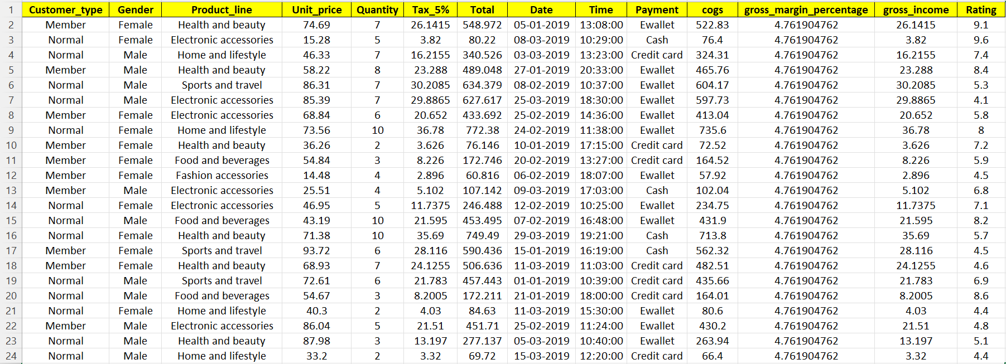

DATASET
1001 ROWS AND 17 COLUMNS

Slide 3
PROBLEM STATEMENT
TO ANALYZE AND DERIVE INSIGHTS FROM WALMART'S SALES DATA TO IMPROVE BUSINESS DECISION-MAKING PROCESSES.

Slide 4
APPROACH
1.Understanding the dataset and the relationships between different columns.
2.Data cleaning (if required)
3.Data sorting
4.Chechking relevancy
4.Developing some rough approach towards the dataset through trial and error.
5.Creating database IN MySQL.
6.Loading dataset
7.WRITING MySQL QUERIES FOR FINDING POSSIBLE SOLUTIE SOLUTIONS
8. Re-checking the queries by running them again
9.Re-writings some queries again if they fail on run
10. Creating a detailed presentation.

Slide 5
1001 ROWS AND 17 COLUMNS
The dataset consists of the following columns:
• Invoice_ID: Unique identifier for each invoice.
• Branch: Branch of the store where the sale took place.
• City: City where the store branch is located.
• Customer_type: Type of customer (e.g., Member, Normal).
• Gender: Gender of the customer.
• Product_line: Category of the product sold.
• Unit_price: Price per unit of the product.
• Quantity: Quantity of the product sold.
• Tax_5%: Tax applied on the sale.
• Total: Total amount of the sale.
• Date: Date of the transaction.
• Time: Time of the transaction.
• Payment: Payment method used (e.g., Cash, Credit Card).
• cogs: Cost of goods sold.
• gross_margin_percentage: Gross margin percentage.

Slide 6
QUESTIONS
1. Retrieve all columns for sales made in a specific branch (e.g., Branch 'A').
2. Find the total sales for each product line.
3. List all sales transactions where the payment method was 'Cash'.
4. Calculate the total gross income generated in each city.
5. Find the average rating given by customers in each branch.
6. Determine the total quantity of each product line sold.
7. List the top 5 products by unit price.
8. Find sales transactions with a gross income greater than 30.
9. Retrieve sales transactions that occurred on weekends.
10.Calculate the total sales and gross income for each month.
11.Find the number of sales transactions that occurred after 6 PM.
12.List the sales transactions that have a higher total than the average total
of all transactions.
13.Calculate the cumulative gross income for each branch by date.
14.Find the total cogs for each customer type in each city.

Slide 7
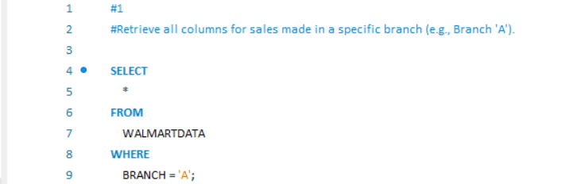
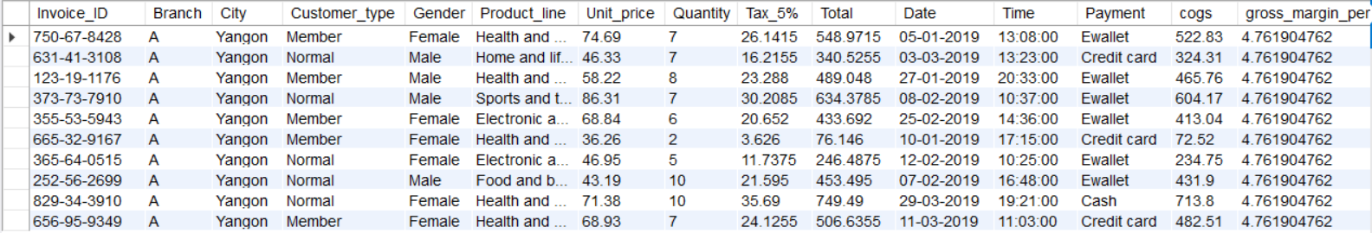
RETRIEVE ALL COLUMNS FOR SALES MADE IN A SPECIFIC BRANCH (BRANCH 'A').

Slide 8
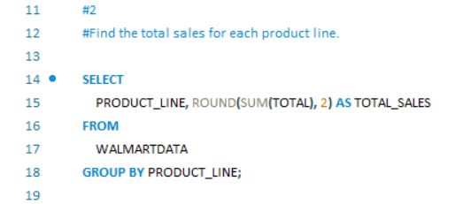
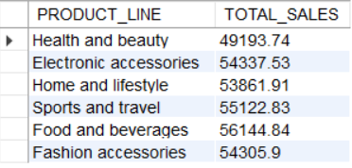
2. FIND THE TOTAL SALES FOR EACH PRODUCT LINE.

Slide 9
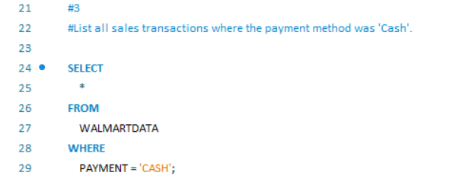
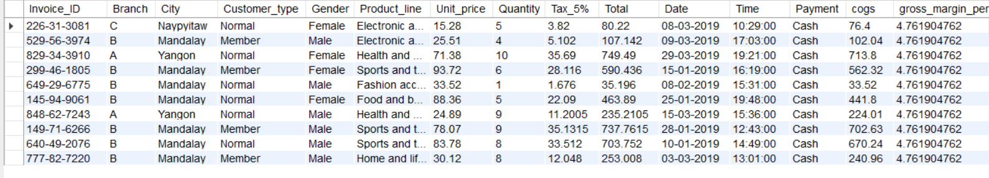
3. LIST ALL SALES TRANSACTIONS WHERE THE PAYMENT METHOD WAS 'CASH'.

Slide 10
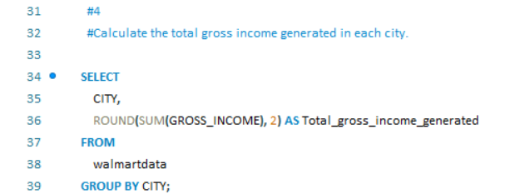
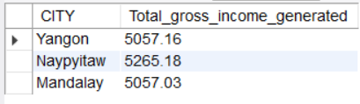
4. CALCULATE THE TOTAL GROSS INCOME GENERATED IN EACH CITY.

Slide 11
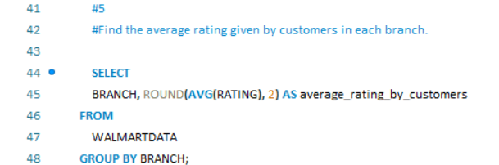
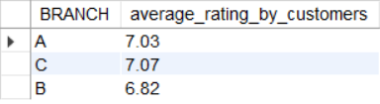
5. FIND THE AVERAGE RATING GIVEN BY CUSTOMERS IN EACH BRANCH.

Slide 12
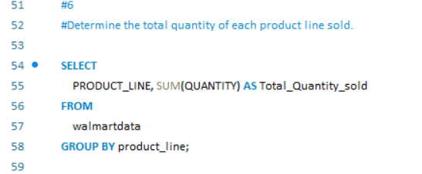
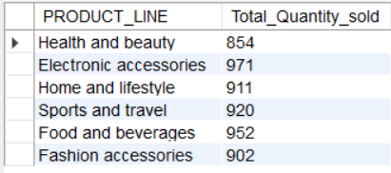
6. DETERMINE THE TOTAL QUANTITY OF EACH PRODUCT LINE SOLD.

Slide 13
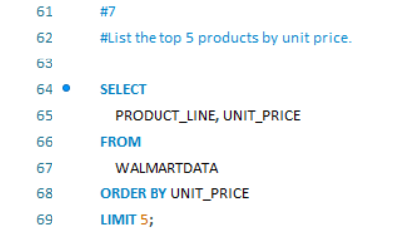
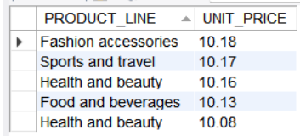
7. LIST THE TOP 5 PRODUCTS BY UNIT PRICE.

Slide 14
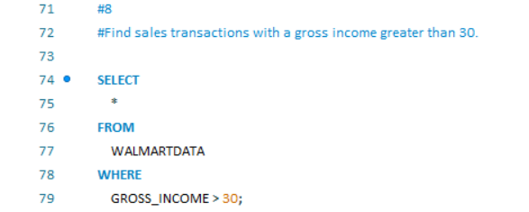
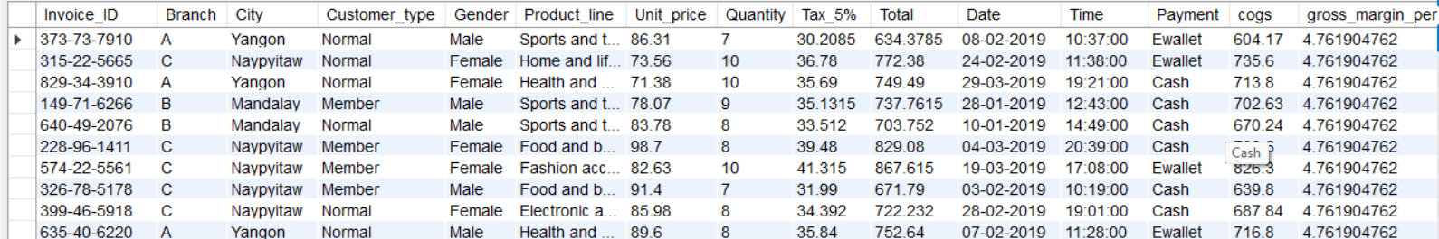
8. FIND SALES TRANSACTIONS WITH A GROSS INCOME GREATER THAN 30.

Slide 15
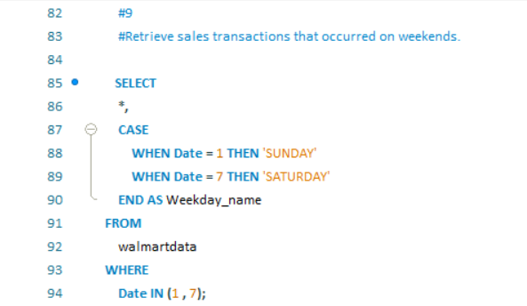
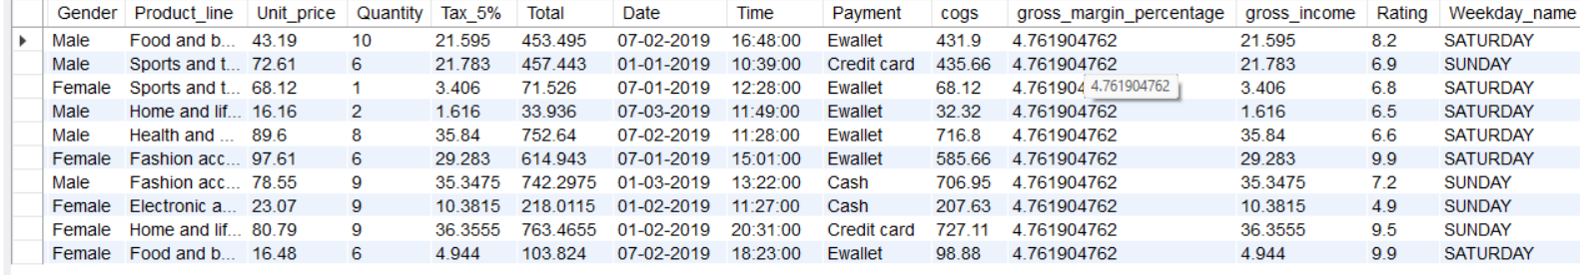
9. RETRIEVE SALES TRANSACTIONS THAT OCCURRED ON WEEKENDS.

Slide 16
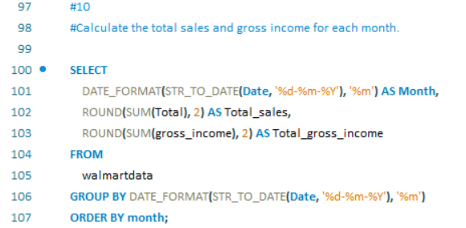
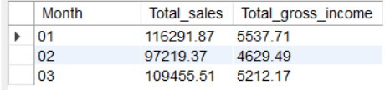
10. CALCULATE THE TOTAL SALES AND GROSS INCOME FOR EACH MONTH.

Slide 17
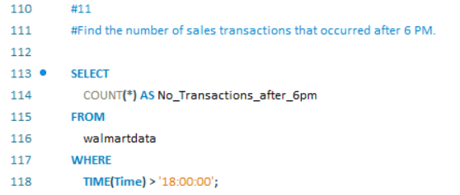
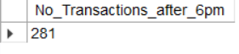
11. FIND THE NUMBER OF SALES TRANSACTIONS THAT OCCURRED AFTER 6 PM.

Slide 18
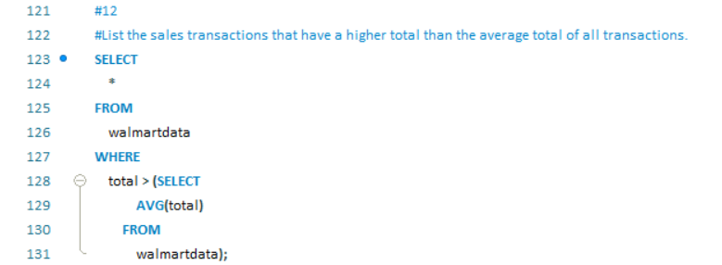
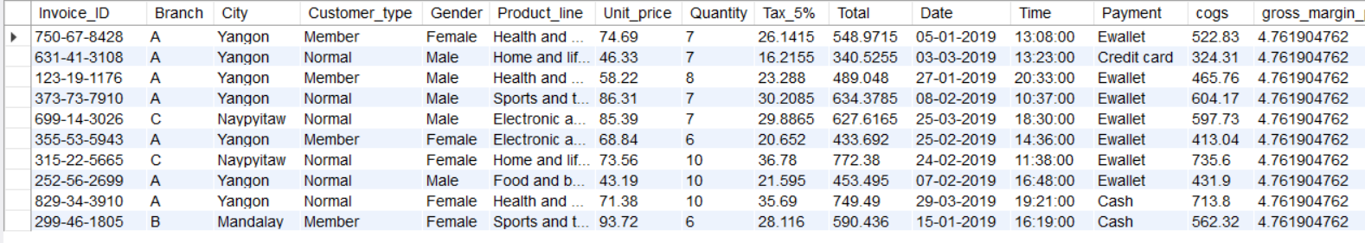
12. LIST THE SALES TRANSACTIONS THAT HAVE A HIGHER TOTAL THAN THE AVERAGE TOTAL
OF ALL TRANSACTIONS.

Slide 19
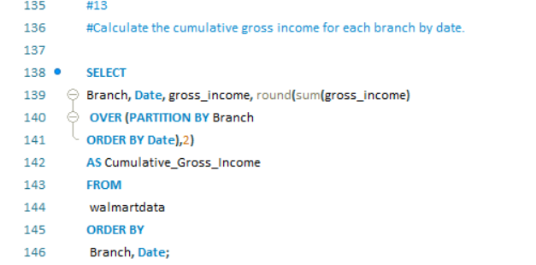
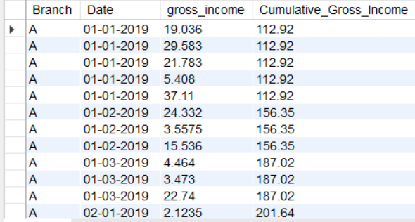
13. CALCULATE THE CUMULATIVE GROSS INCOME FOR EACH BRANCH BY DATE.

Slide 20
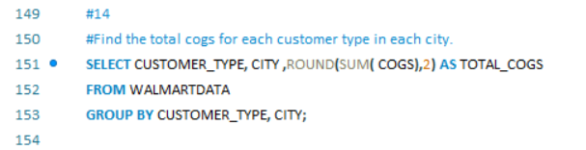
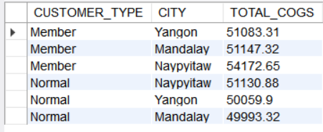
14. FIND THE TOTAL COGS FOR EACH CUSTOMER TYPE IN EACH CITY.

Slide 21
KEY FINDINGS
Food and beverages product line has the highest total sales among other 6 categories of product lines
Highest Gross income generated among the three cities was Naypyitaw with 5265.18 Gross income.
Highest average rating is in the branch C with an average rating of 7.07
Highest quantity sold for the electronic accessories product line is the highest with 971 units sold and least is the health and accessories product line with 854 units.
Highest selling product by Unit price is Fashion and accessories with 10.18
For January(1) month the total sales is the highest with 116291.8 and gross income with 5537.7 and lowest for February(2) month.

Slide 22

THANK
YOU

